Slide 1
Welcome
Expanding the Dream:
Connecticut Colleges Leverage “ATD”
And the Developmental Education Initiative
as a Foundation for
Carnegie Foundation’s STATWAY

Slide 2
Presenters:
Dr. Elizabeth Roop, Academic Dean
Housatonic Community College, Connecticut
Dr. Mary Ann Affleck, Academic Dean
Capital Community College, Connecticut
Professor Andre Freeman, Chair of the Science and Mathematics Department, Capital Community College
Jan Schaeffler, Institutional Researcher, Housatonic Community College

Slide 3
Achieving the Dream and Developmental Education Initiative
Focus: Student Success on a Substantial Scale
Premise: Fundamental Change in Operations
Overall Objective: Success of Community College Students, Especially Students of Color and Low-Income Students

Slide 4
Success as defined by:
1)Completion of Developmental Courses
and entry into credit courses
2) Completion of Gateway
Courses with a 'C' or better grade
3) Persistence Term-to-Term and
Year-to-Year
4) Completion of a Certificate or Degree

Slide 5
Characteristics of ATD/DEI Colleges:
Committed Leadership
Use of Evidence or Data-Driven Practice to Improve Programs and Services
Broad Engagement
Systemic Institutional Improvement

Slide 6
Leadership
Senior college leaders actively support student success efforts
All on campus work to make changes in policies, programs and resource allocation

Slide 7
Evidence: Data-Driven Practice
Established Processes for using data about student progress and outcomes
Data used to:
Identify and address achievement gaps
Improve overall success
Evaluate intervention strategies

Slide 8
Engagement
Collaborative across college areas (Limited number of strategies
(usually 2 - 4 max, and eventual campuswide committee)
Constituents Beyond the College included in the discussion
Inclusion of students (through surveys, focus groups, advisory groups)

Slide 9
Systemic Institutional Improvement
Planning processes rely on data
Set Goals
Measure Goal Attainment
Regular review and and evaluation of programs and services
Resources Based on Program Effectiveness
Professional Development (to reinforce new services, programs)

Slide 10
Five Steps Involved in Being an Achieving the Dream/Developmental Education Initiative College
Commit to Improving Student Outcomes
Use Data to Prioritize Actions
Engage Stakeholders to Help Develop Plans/Strategies
Implement, Evaluate and Improve Strategies
Establish a Culture of Continuous Improvement

Slide 11
In summary, powerful elements in Achieving the Dream provided a foundation for the work of Statway.

Slide 12
Synthesis
Statway
Research-based
The Dream
Data-Driven

Slide 13
Statway Collaboratory
Carnegie Foundation Researchers
Community College Faculty Nationwide
One Problem

Slide 14
MATH

Slide 15
College Math Reconsidered
Curriculum
Pedagogy
Student Mindset
Professional Development
Assessment/Evaluation

Slide 16
Curriculum: Existing Math Pathway
Pre-Algebra
Elem. Algebra
Intermediate Algebra
Precalculus
Statistics

Slide 17

Pedagogy
Problem-based Learning
Collaborative Student Effort
Supporting Software

Slide 18
Student Mindset
Specific exercises in the course to address psychological barriers to math success.

Slide 19
Professional Development
Course Embedded “Japanese Lesson Study”

Slide 20
Assessment/Evaluation
Formative
Course-Embedded
Analyses based on Student Use of Course Software
Comparative data from multiple institutions on a single intervention

Slide 21
Why Statistics?
Statistics provides students a “fresh start” and enables students to apply their mathematical reasoning towards new problems in a new context
Statistics will increase quantitative literacy of the large population of young adults placing into developmental mathematics
Many developmental math students will take statistics as their college-level mathematics course after completing their developmental math courses

Slide 22
Lesson Design Principles
Productive Struggle – Students expend effort to solve statistical/mathematical problems which are within reach but not readily apparent
Explicit Connections – Teaching that attends explicitly to concepts, establishing connections among facts, procedures and ideas
Deliberate Practice – Structured homework activities designed to improve performance and strengthen understanding

Slide 23
Lesson – Sampling Distributions
What proportion of community college students find developmental mathematics courses relevant to their career interests?
Is this result a population proportion or a sample statistic?
Can we find this figure?
How can we estimate this figure?
Each practitioner must find a sample proportion from a random sample of 25 students
Notes:
This activity is a derivation of Lesson 7.1.1, in the second semester of Statway, in which students use sample statistics to estimate the proportion of all milk chocolate M & M’s that are blue. The context has been adjusted to present a problem that is of significant interest to participants in this workshop.

Slide 24
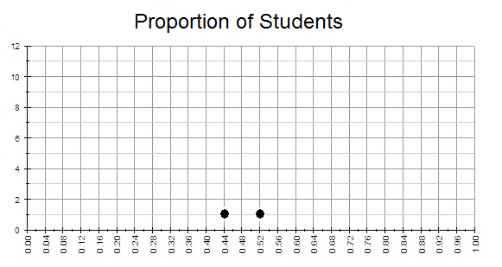
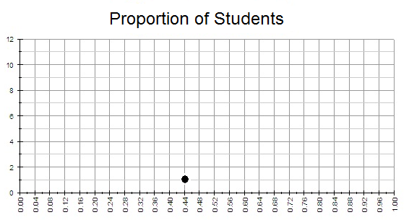
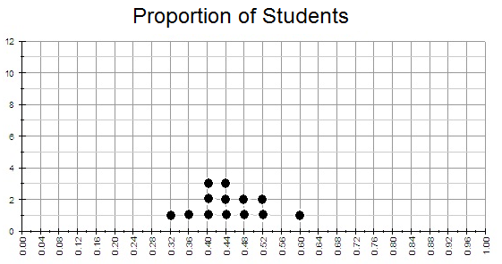
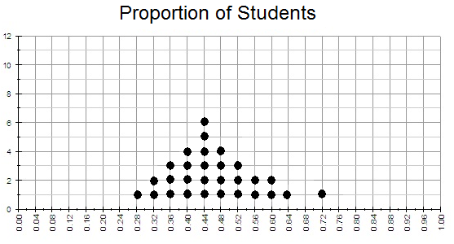
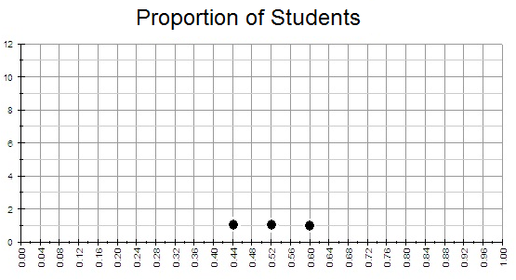
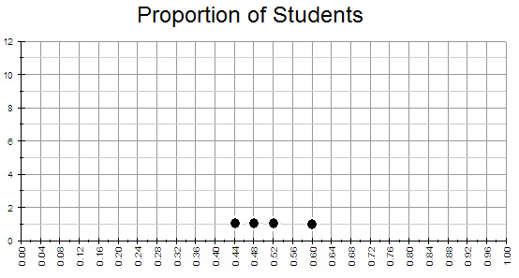
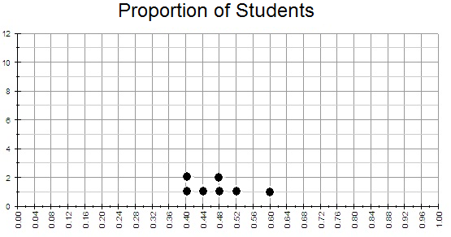
Distribution of Sample Proportions
Notes:
This animated slide shows how students contribute their sample proportions to create a distribution of sample proportions.

Slide 25
Based on these sample proportions, what is the best estimate for the true proportion of community college students who find developmental mathematics courses relevant to their career interests?
Notes:
Other questions: Do the sample proportions vary by a large amount? Are all the sample proportions the same?

Slide 26
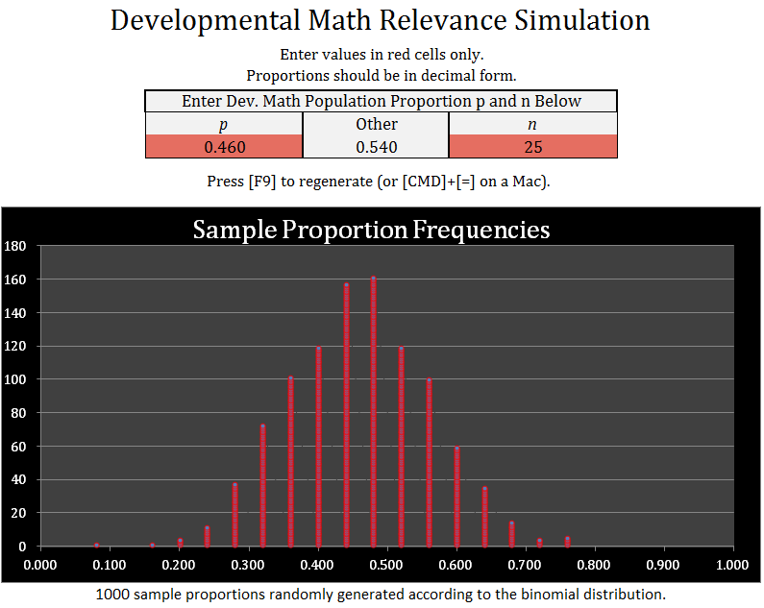
Notes:
The simulation accepts as inputs the population proportion and a sample size. How does the sample size affect the shape of the sampling distribution?
These activities are an example of a “rich task”. Rich tasks allow students to gather data and/or examine data, explore characteristics of the data to explore a statistical concept, and, when appropriate, use technology to simulate the affects of changing values in statistical models and to develop a stronger conceptual understanding.

Slide 27
Early Impressions
Developmental mathematics students can learn statistics given an environment which contains:
Problem-based learning opportunities
In-class activities (rich tasks)
Just-in time mathematics
Out of class academic support
College success coaching
Technology

Slide 28
Institutional Research Update
Data collection for Assessment
Student Background Characteristics
Basic Demographics
Language Background
Dynamic Engagement Data (real-time data)
Class Engagement Data
Outside of Classroom Engagement Data
Short ongoing student survey of how students are feeling/experiencing Statway
Creating baseline data from pilot year to predict student behavior in future Statway courses

Slide 29
Examples of Data Collection
What is the highest level of education of the woman (mother, grandmother, etc.) who mostly raised you when you were growing up?
Which of these statements best describes you?
I grew up in a home where only English was spoken.
I grew up in a home where both English and a language other than English were spoken.
I grew up in a home where only a language other than English was spoken.

Slide 30
Examples of Data Collection
In general, how useful are the things you learn in Math class for meeting your goals in life?
Responses on 5 point scale from “Very Useful” to “Not Useful at All”
Overall, how personally interesting is math class to you?
Responses on 5 point scale from “Very Useful” to “Not Useful at All”
Overall, how often do you feel you belong in this college?
Responses on a 5 point scale from Very Often to Never

Slide 31
My Statway
In addition faculty are using a program called “MyStatway” Students sign in and do work and the program tracks their keystrokes and path to solving problems.

Slide 32
Productive Persistence
Students Need Skills and Habits Required for College Success
Attendance
Assignments
Help-Seeking
Learning from Errors
Effort after Failure
Embracing Challenge
Students have Weak Ties to Peers, Faculty, and Course of Study
Students Don’t See Themselves as Math Learners
Course material Not Seem As Interesting or Useful
Mindsets
Skills
Source: Carnegie’s David Yeager’s presentation on student success and productive persistence as part of the 2011 winter institute.

Slide 33
Fixed Mindset
Growth Mindset
Gain Higher Achievement

Slide 34
Summary/Conclusion

Slide 35
ATD
Statway
New Vision

Slide 36
Powerful Elements in Statway Upon Which ATD Colleges Could Build

Slide 37

Collaboratory: Multiple Colleges and Researchers Tackle One Problem Simultaneously
ATD
Statway

Slide 38

A Rare Direct Collaboration Between Research and Practice
Carnegie Researchers
Community College Faculty

Slide 39
Fundamental Re-design of Curriculum
Carnegie researchers questioned a traditional math pathway and designed an alternative for non-stem majors.
Practitioners are testing the new design.

Slide 40


Pedagogy: Research Emphasis on How People Learn

Slide 41

Student Mindset
Unique, Direct Intervention, Based on Current Research and Embedded in the Classroom

Slide 42
Professional Development: Lesson “Study Method” Introduced by Carnegie Researchers
Formative
Course-embedded
Collaborative
Affordable

Slide 43
Assessment/Evaluation
Multiple Methods
Formative
Includes Assessment of Student Attitudes
Classroom Embedded

Slide 44

Questions

